Slide 1

Saudi Arabia Used Car

Slide 2
Objective
Identify the biggest used car market region (helps target resources and marketing).
Discover the most popular used car brand (guides buyers towards reliable options).
Understand key factors affecting used car price (empowers informed decisions for buyers and sellers).
Establish price range for 4-year-old used cars (sets realistic expectations).
Analyze used car market trends (growth, consumer preferences, online vs. offline sales, regulations)

Slide 3

About the dataset

Slide 4
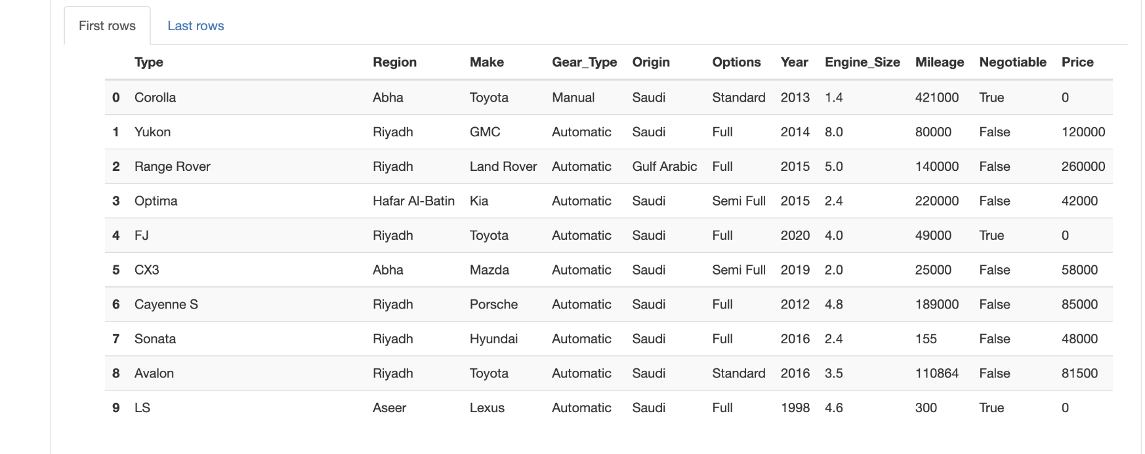
Dataset sample

Slide 5
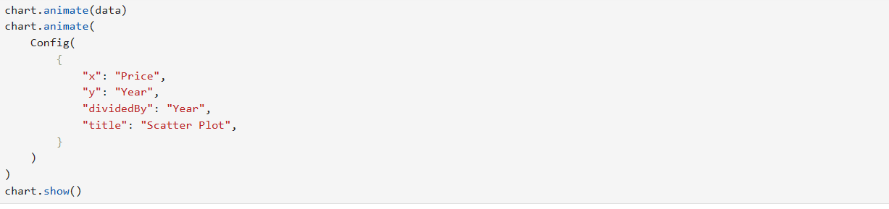
IPYVIZZ issue

Slide 6
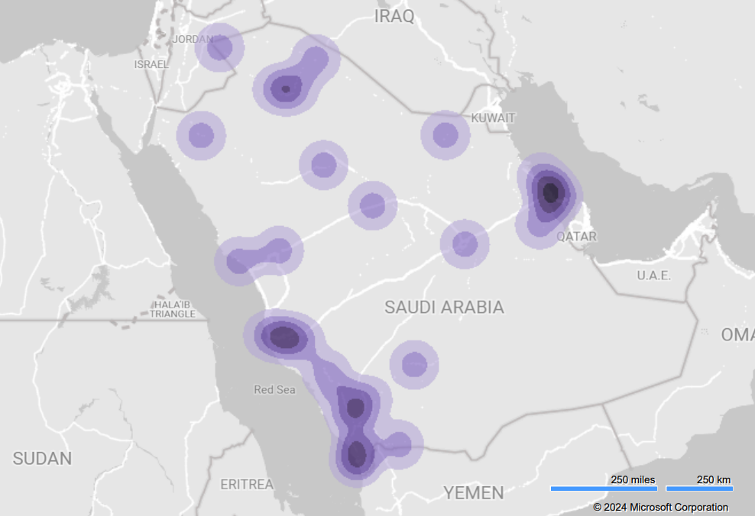
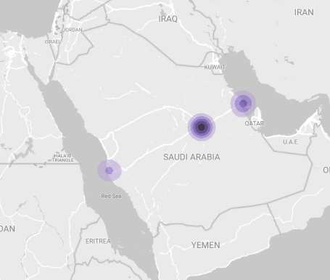
Heatmap for Saudi Arabia Buyers
highlighting those that appear most buyers

Slide 7
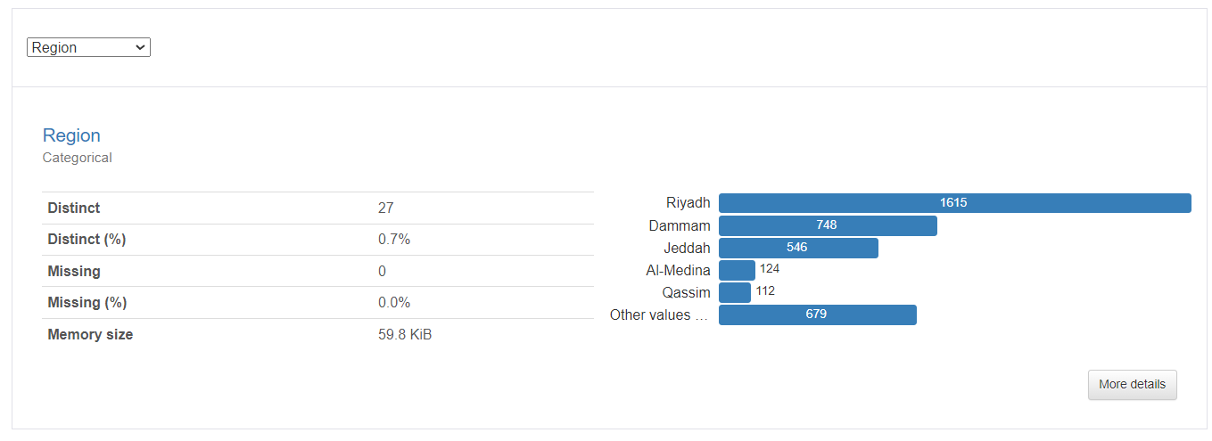
THE LARGEST REGION FOR SELL CARS

Slide 8
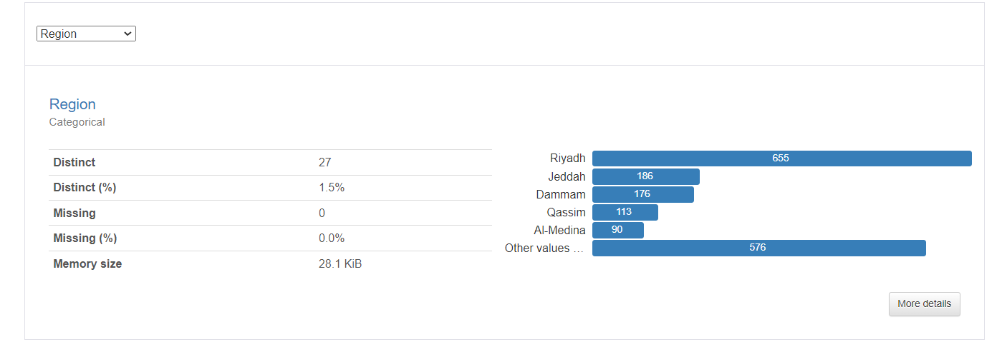
THE LARGEST REGION FOR NONE-SELL CARS

Slide 9
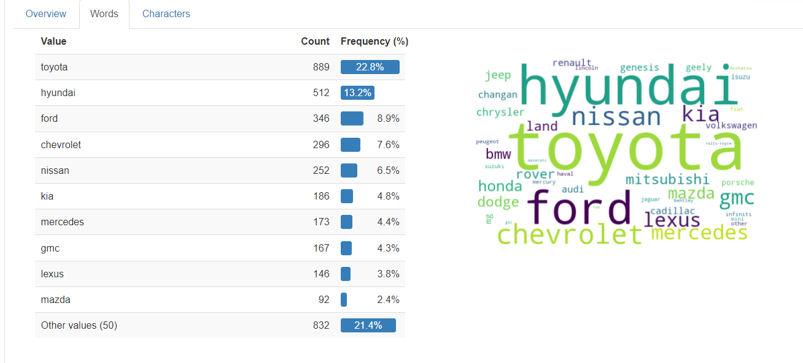
MOST LISTED BRAND FOR SALE

Slide 10
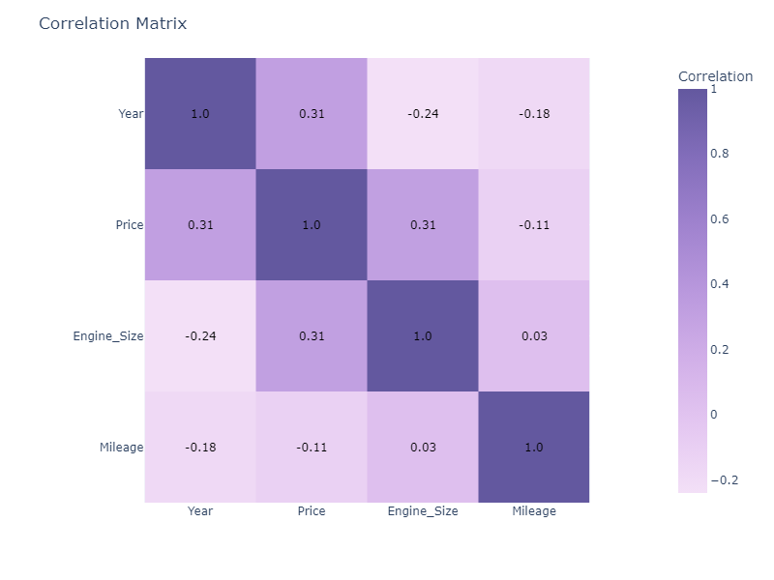
MOST FACTORS THAT INFLUENCES THE PRICE
National Rank

Slide 11
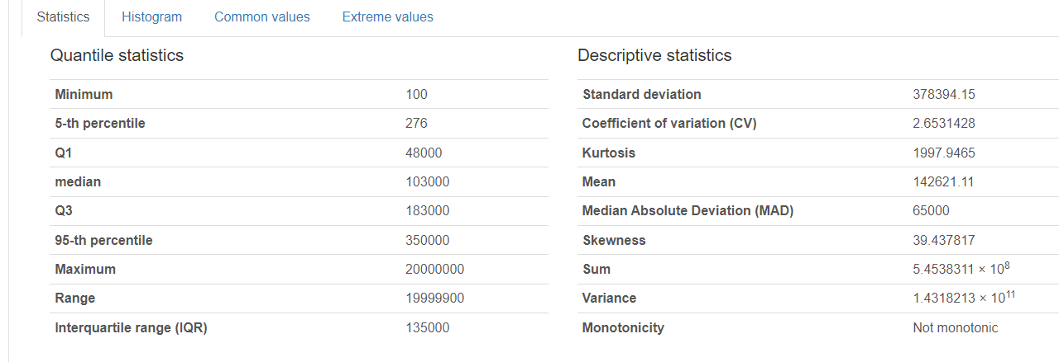
MILEAGE STATISTICS

Slide 12
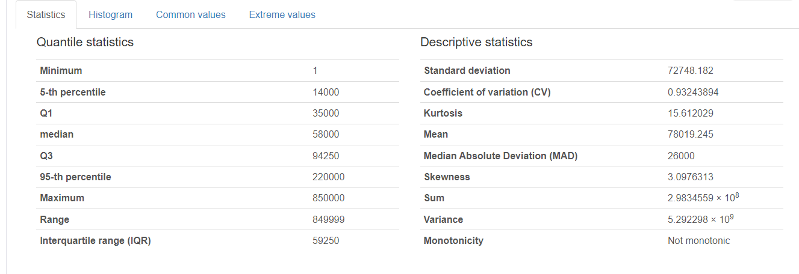
PRICE STATISTICS

Slide 13

Game time

Slide 14

Thank you

